Slide 1
Arduino Terrabox_Widgets
The concepts

Slide 2
Screen
*parent
*child
Child 1.1
*sibling
Child 1.n
Child 2.1
Child 2.n
Parent, child and sibling relations
To iterate over all the children, get the child pointer from the parent and follow the child its sibling pointers

Slide 3
UL
A
LR
B
Ulx(A) <= Ul_{x}(B) <= URx(B) || ULy(A) <= Uly(B) && LRy(A)

Slide 4
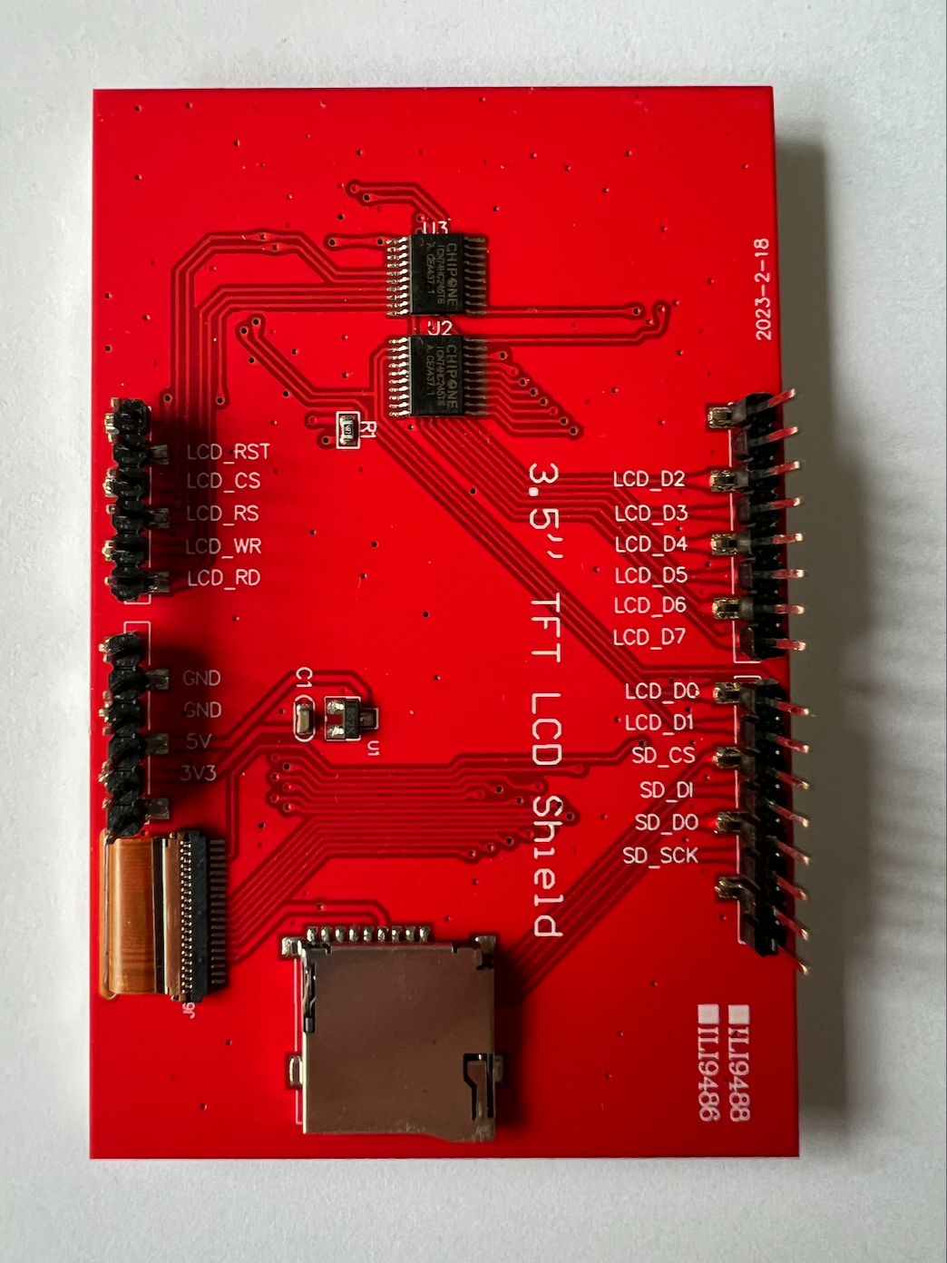
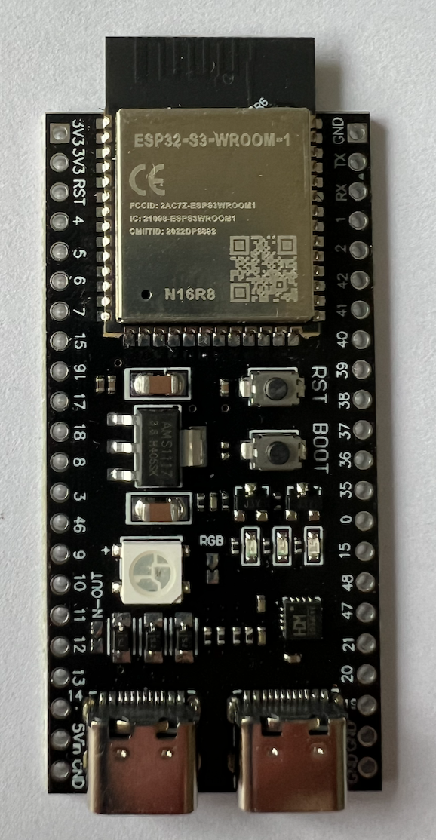
Connecting ESP32 S3 Devkit 1 to Arduino UNI shield for ILI9488
RST
DC/XN
A1
RST
WR
A2
XM
CS
D2
RD
A3
YP
RS
B3
D3
A4
WR
B4
D4
A5
RD
B5
D5
B6
D6
B7
D7
B0
XP
D8
B1
YM
D9
CS
D10
MOSI
D11
MISO
D12
SCLK
D13
CS
MOSI
SPI2
SCLK
MISO

Slide 5
Connecting ESP32 S3 Devkit 1 to Arduino UNI shield for ILI9488
RST
DC
A1
RST
WR
A2
CS
RD
A3
RS
A4
WR
A5
RD
CS
D10
MOSI
D11
MISO
D12
SCLK
D13
CS
MOSI
SPI2
SCLK
MISO

Slide 6
TOP
VIEW
(TFT side up)
TFT Par
TFT SPI
Touch
Ard. pin
B2
D2
RST
B3
D3
LCD_D2
LCD_RST
A1
RST
YP
DC/XN
B4
D4
LCD_D3
LCD_CS
A2
CS
XN
WR
B5
D5
LCD_D4
LCD_RS
A3
RS
YP
RD
LCD_D5
LCD_WR
A4
WR
B6
D6
LCD_D6
LCD_RD
A5
RD
B7
D7
LCD_D7
XP
B0
D8
LCD_D0
GND
YN
B1
D9
LCD_D1
CS
D10
SD_CS
GND
MOSI
D11
SD_DI
5V
MISO
D12
SD_DO
3.3V
SCLK
D13
SD_SCK
XP
CS
YN
MOSI
SPI2
SD
Card
SCLK
MISO

Slide 7
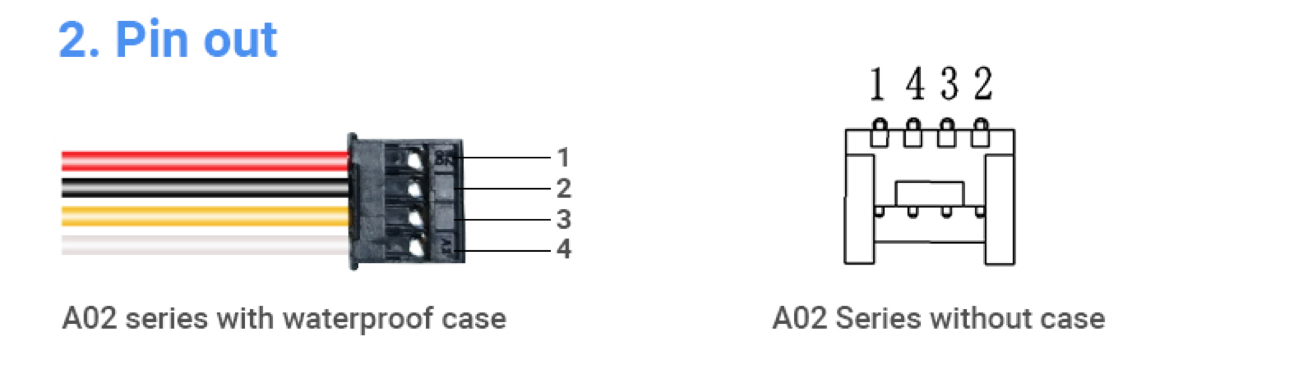
Sensor A02 split module, connections

